Slide 1

Daniel McCann
Competency Portfolio
www.infratec-uk.com

Slide 2
Competency Summary
Category | Accreditation Body | No. | Expiry
Safe Moving and Handling | Qualsafe Awards | 3291708 | 20/02/2027
Emergency First aid at work (Lvl 3) | Qualsafe Awards | 3024687 | 14/02/2026
IPAF (1B) | IPAF | OP/1974502 | 31/05/2026
A40 Slinger / Signaller | CPCS | 40616816 | 31/12/2026
A62 Crane Lift Supervisor | CPCS | 40616816 | 31/12/2026
A61 Appointed Person Lifting Operations | CPCS | 40616816 | 31/12/2026
HERS Qualified Supervisor | HEA | QS10726 | 16/05/2029
HERS Authorising Officer | HEA | CA10524A | 18/08/2025
HERS / ECS | CSCS | H1188689 | 23/09/2025
National Highways Safety Passport | National Highways | 14-00013945 | 06/01/2026
Working at Height Level 2 (RQF) | Qualsafe Awards | 3021030 | 15/02/2026
www.infratec-uk.com

Slide 3
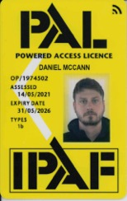
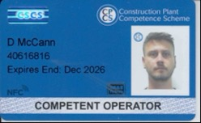

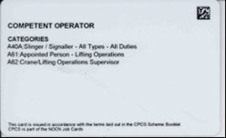
Competency Cards
CPCS
IPAF
HERS
www.infratec-uk.com

Slide 4
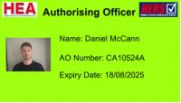
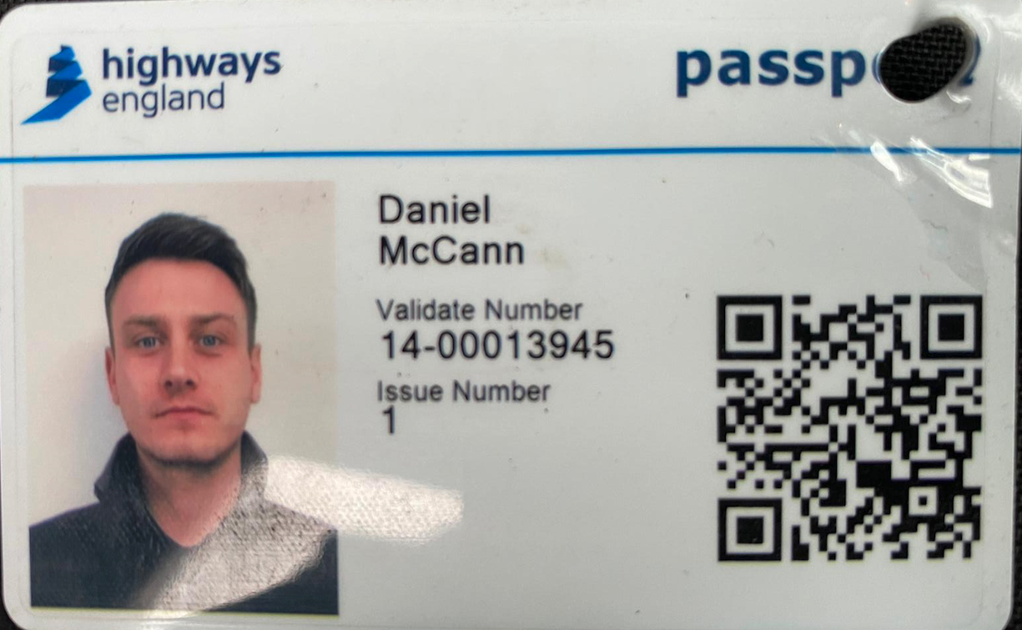
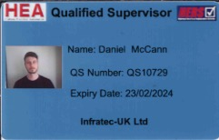
Competency Cards (cont.)
HERS
GVC - Drone
National Highways Safety Passport
HERS
www.infratec-uk.com

Slide 5
Certificate of Fitness for Work/Role & Additional Training
Other Training
NEBOSH National General Certificate in Occupational Health and Safety, 3 December 2013, Certificate No: 00191997/540757.
BTEC Level 3 in Engineering (QCF), Redcar and Cleveland College, 5 July 2015.
Safety Harness Awareness, NETA Training Group, 31 March 2017, Certificate No: 17124.
Site Management Safety Training Scheme (SMSTS), CITB, 13 July 2018, Certificate No: 639628.
Institution of Occupational Safety & Health, Working Safely, 11 February 2019, Certificate No: WS572877.
HEA/HERS Authorising Officer, August 2020, certificate No: CA10524.
United Kingdom Unmanned Aircraft Systems – Remote pilot certificate of competence – Certificate No: 10625, Expiry 21-12-2025.
HEA/HERS Qualified Supervisor, February 2021, certificate No: LDRSYQ22
NETA Training Group, Flame Cutting. Certificate No: 14827
www.infratec-uk.com

